Slide 1
Modeling the NCAA Tournament with Python
A Four part series!

Slide 2
Part 4 of 4: Model Evaluation

Slide 3
Who am I?
B.S. Economics & Computational Mathematics
Vice President, Co-Founder, MSU Data Science
Python Enthusiast

Slide 4
Final Part of a Four Part Series!
Required Knowledge:
Beginner Knowledge of Python 3
A Healthy Interest in Statistics and Machine Learning
January
Web Scraping
February
Data Mining
March
Choosing a Model
April
Model Evaluation
Feature Engineering
Stats vs. ML
I will share each presentation at facebook.com/MSUDataScience
Notes:
Today, we’ll only need to know about Python

Slide 5
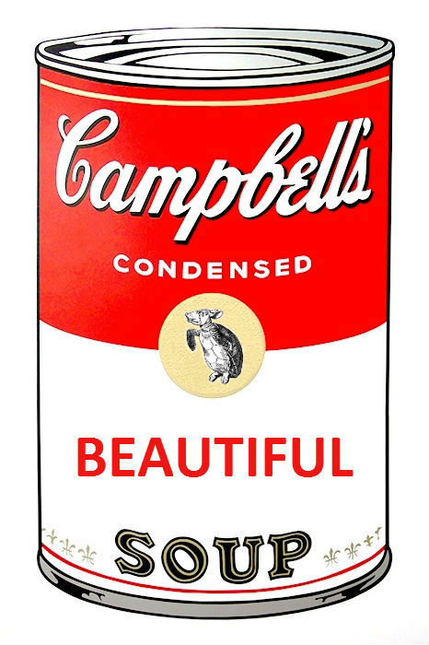
What’s Ahead
Why Do I Need to Scrape?
Brief Intro to HTML
Scraping with BeautifulSoup
Faster Scraping
Friendlier Scraping
Writing CSVs
Scraping Politely (Not Illegally)

Slide 6
Why Do I Need Web Scraping?
Data Mining is Sexy
Web scraping is data mining’s less sexy cousin.
You have an interesting question, but no data. What do you do?
Use Open Data
/r/opendata, /r/datasets, various github repositories.
Collect Your Own Data
Psychology studies at MSU, data entry jobs for professors.
Steal Scrape the Data
Web crawlers/spiders
Notes:
Farmer Analogy
If you have no food, you have some options:
Use Open Data (go to McDonald’s)
Collect your own data (start a garden)
Scrape the data (go grocery shopping)

Slide 7
<h1>Review of HTML</h1>
Hyper-Text Markup Language
Structured Data
How the internet talks
You don’t need to be a web dev to scrape effectively!
Example
Notes:
Hypertext: Think “hyperlink.” Hypertext facilitates linking topics within text.
HTML is structured data

Slide 8
Scraping with BeautifulSoup
The BeautifulSoup gives us the tools to make sense of this structured data.

Slide 9
Faster Scraping

Slide 10
Writing CSVs

Slide 11
Scraping Politely (not illegally)

